Slide 1
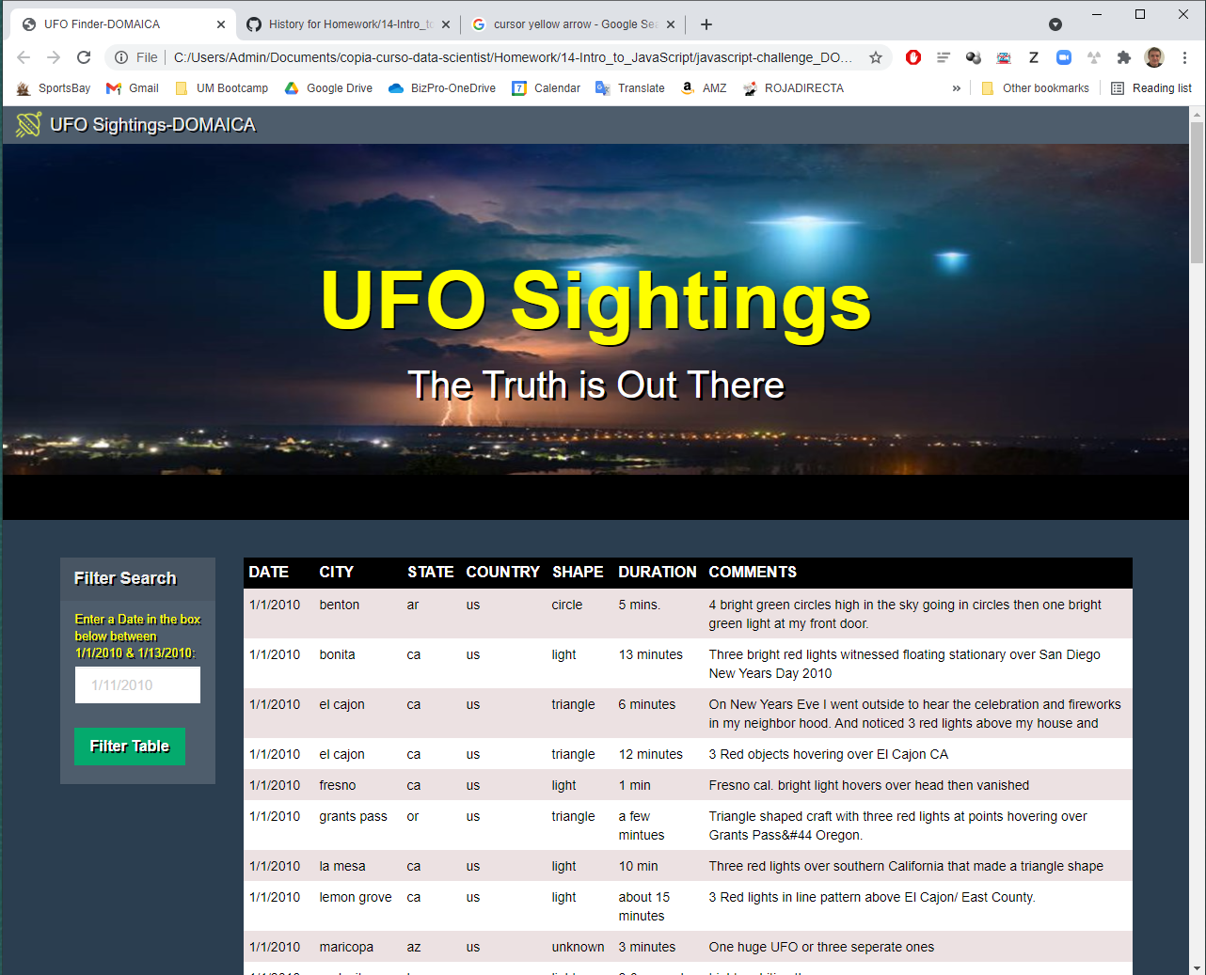
UFO-LEVEL-1. Detail of index.html webpage

Slide 2
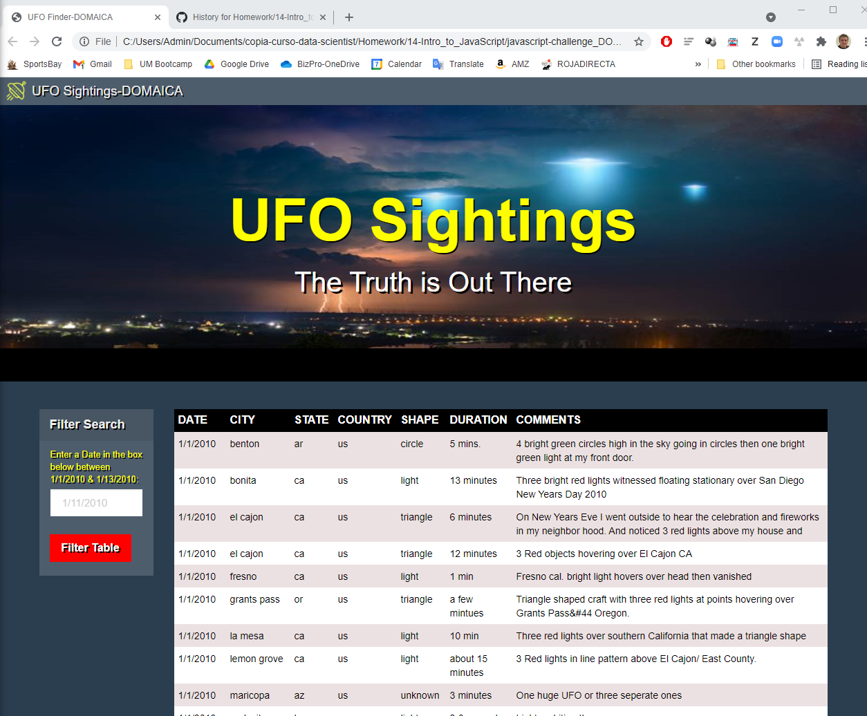

UFO-LEVEL-1. Detail of hovering over filter button change to red color

Slide 3
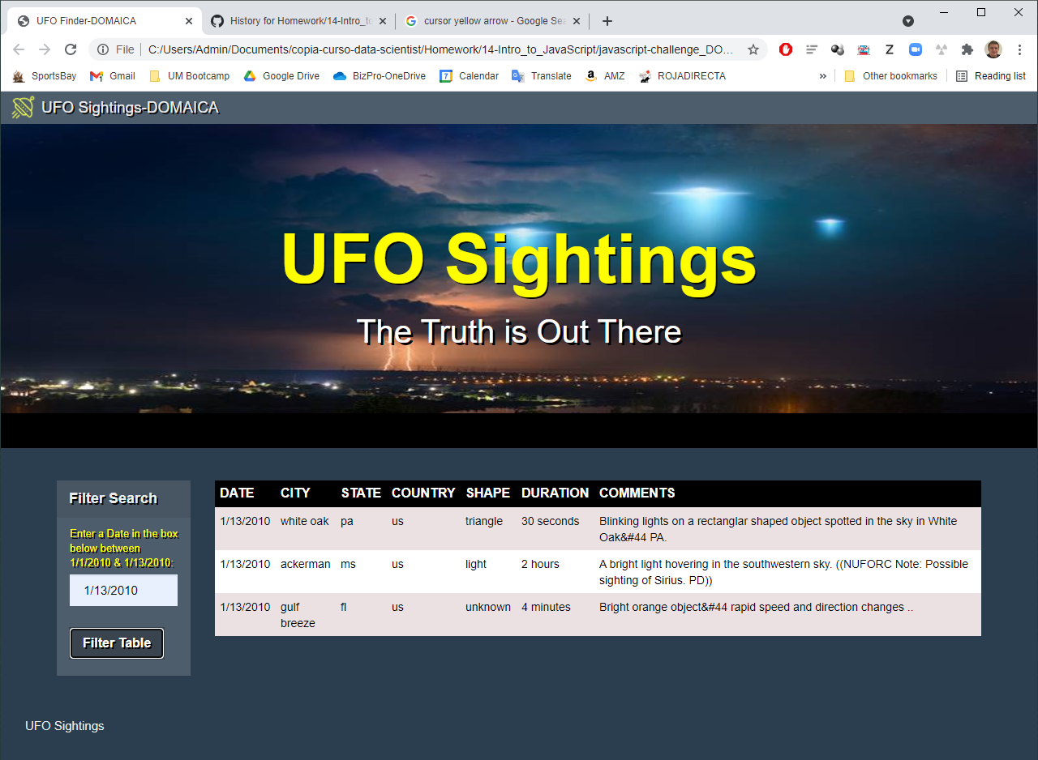
UFO-LEVEL-1. Table filtered for 1/13/2010

Slide 4
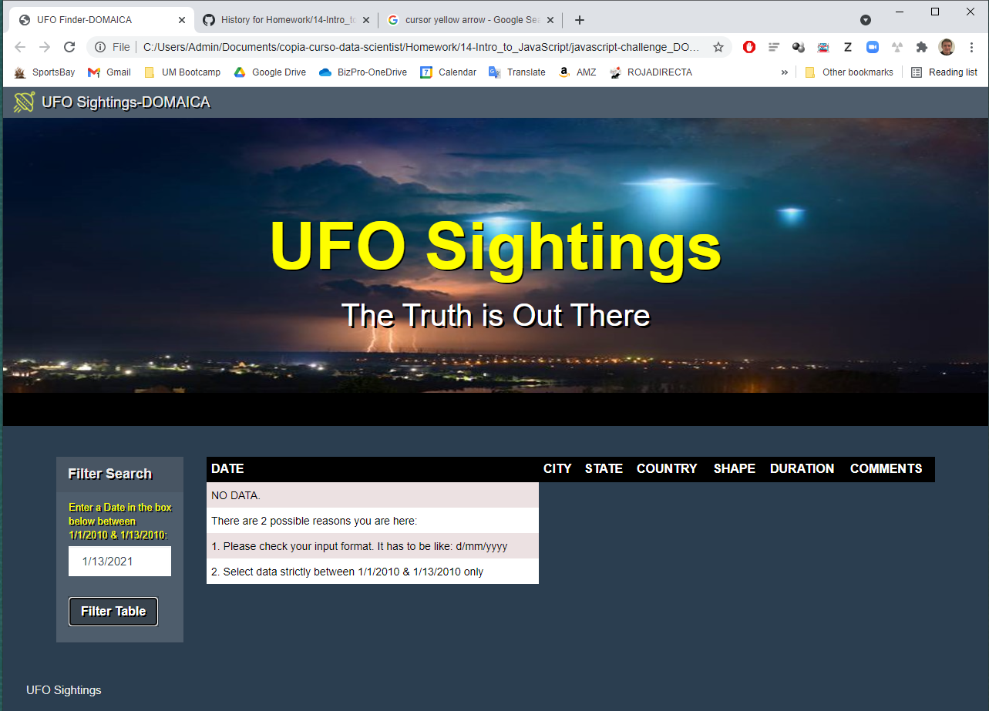
UFO-LEVEL-1. Error feedback

Slide 5
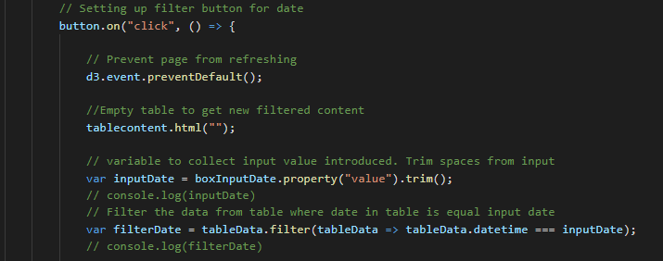
UFO-LEVEL-1. If input has spaces before of after introduced date, it works by trimming spaces

Slide 6
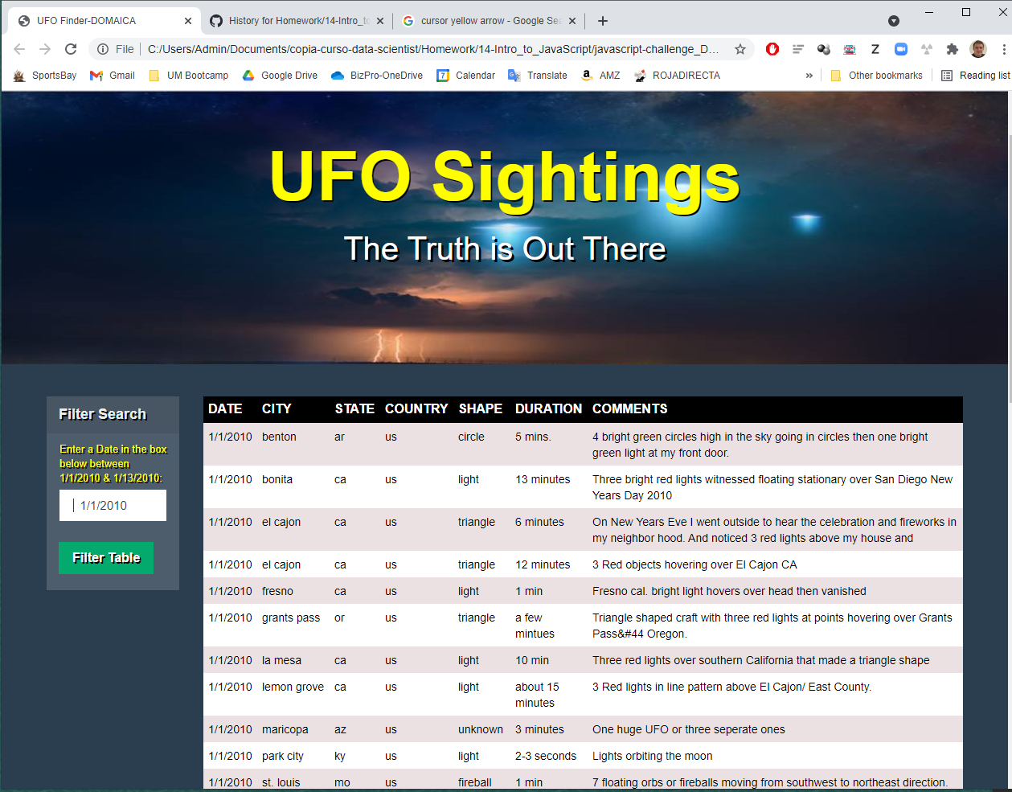
UFO-LEVEL-1. Trimming example.
2 spaces added before date
& still filtering proper results

Slide 7
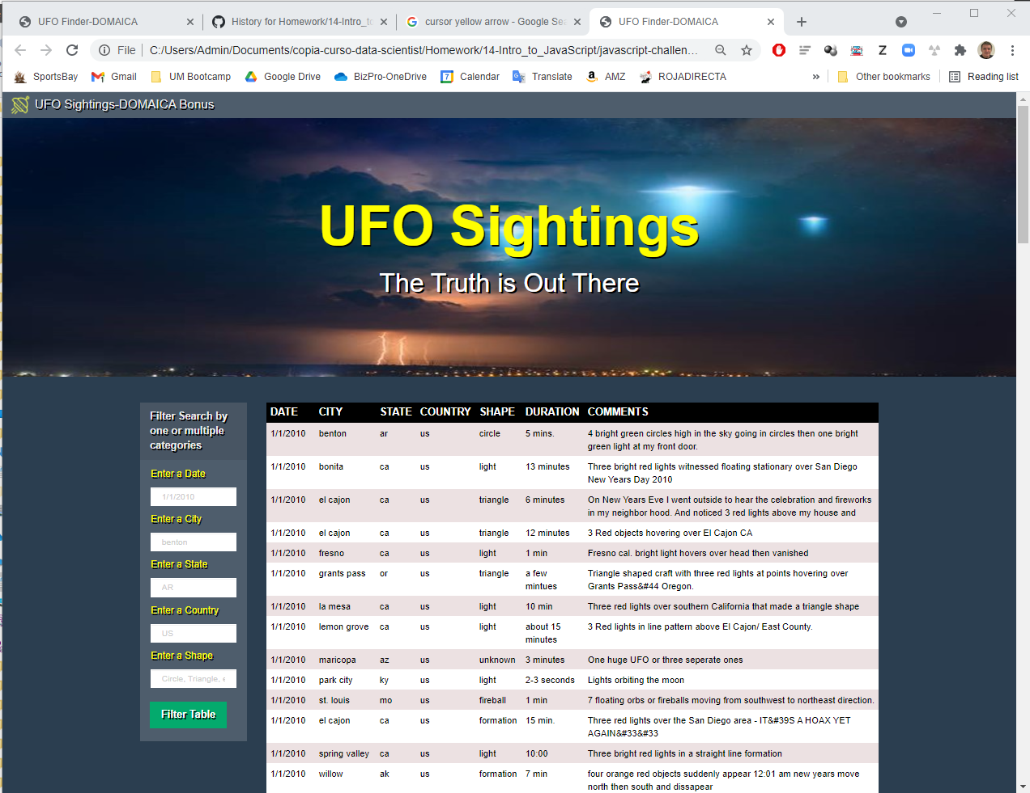
UFO-LEVEL-2. Detail of index.html webpage
Multiple filter categories

Slide 8
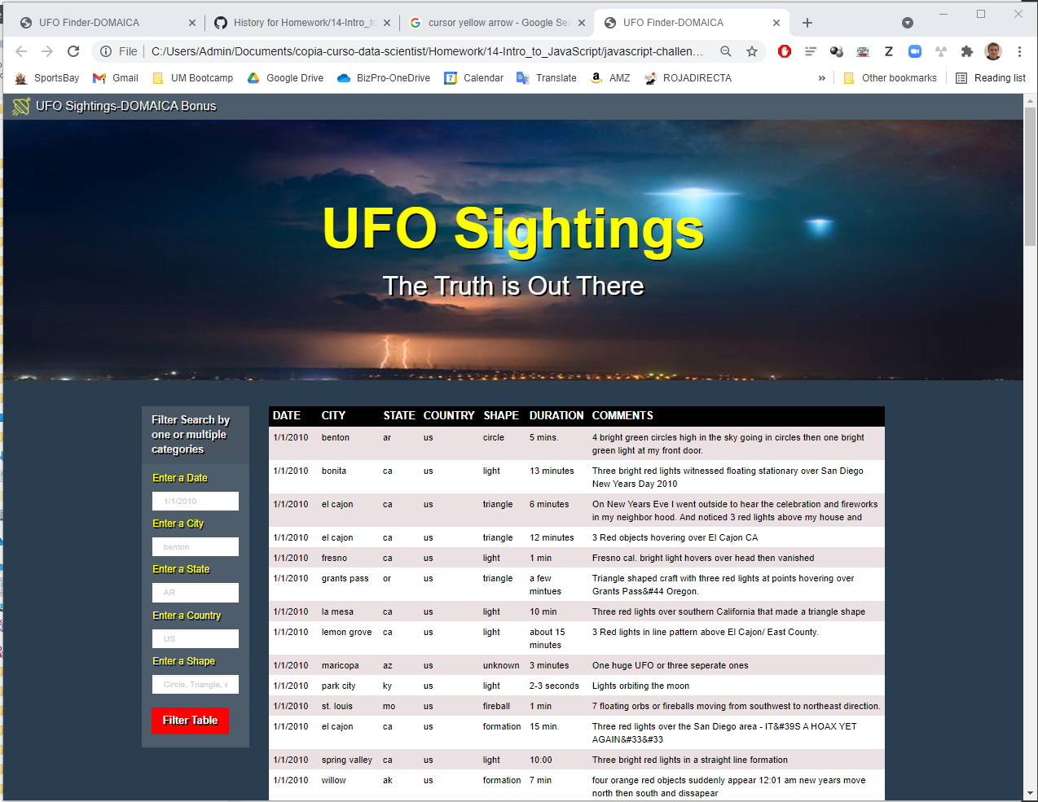
UFO-LEVEL-2. Detail of hovering over filter button change to red color

Slide 9
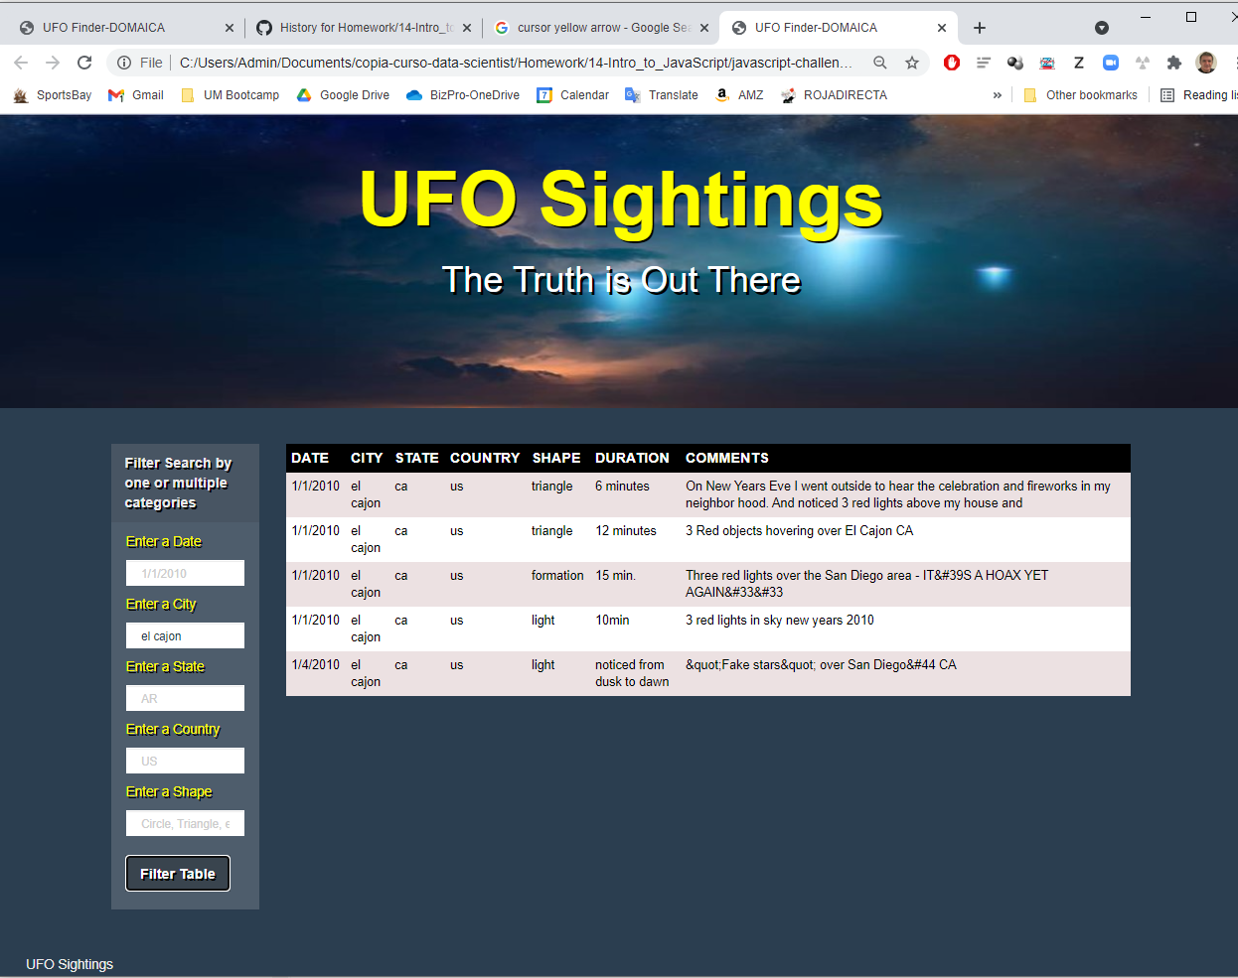
UFO-LEVEL-2. Results filtering on 1 criteria (city). ‘el cajon’

Slide 10
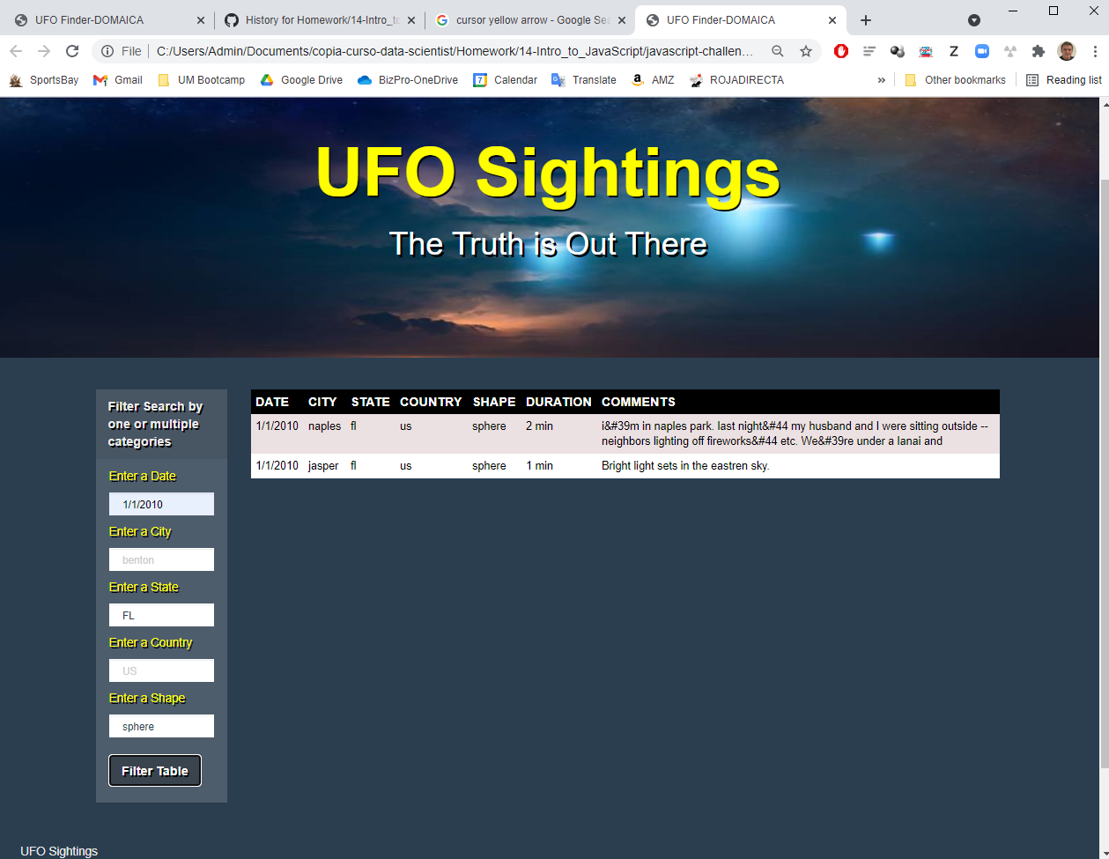
UFO-LEVEL-2. Results filtering on multiple categories:
Date: 1/1/2010 State: FL
Shape: sphere

Slide 11
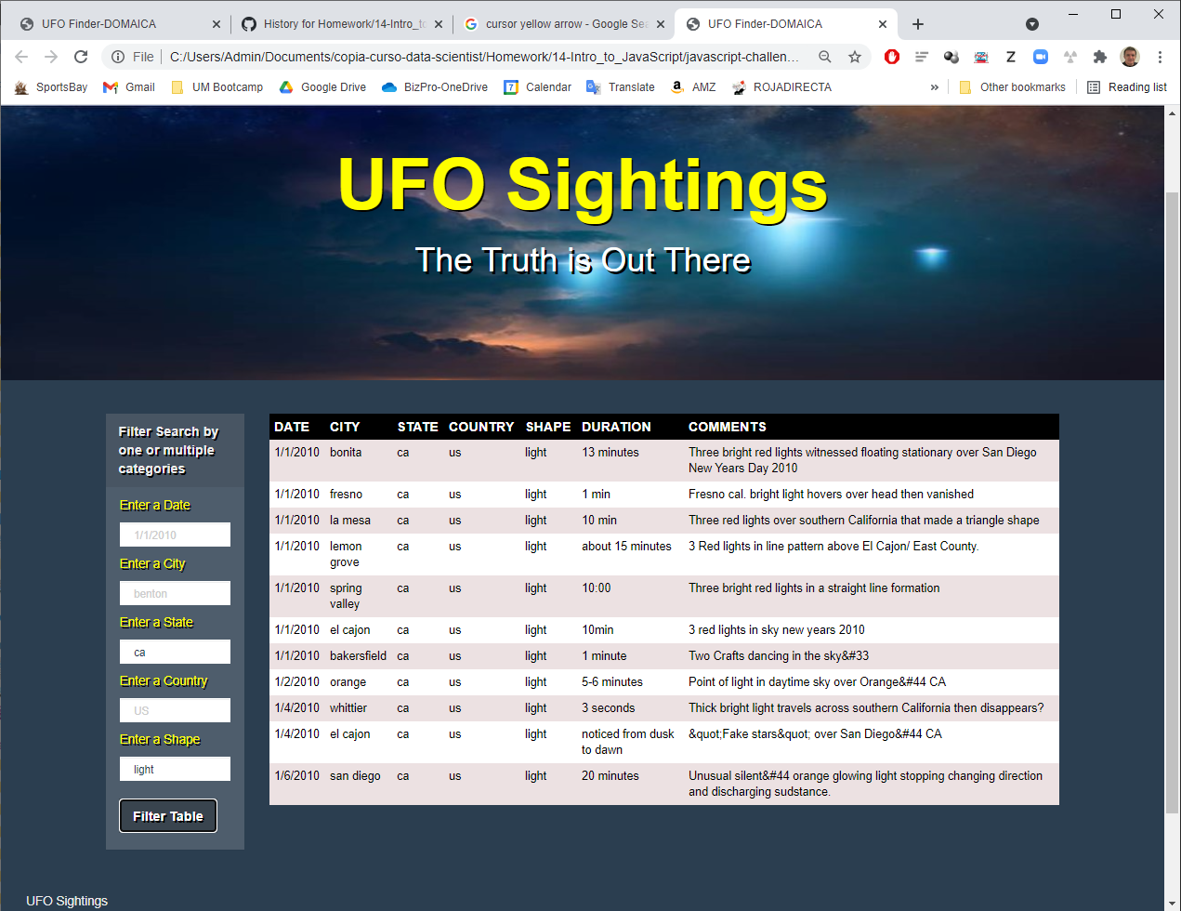
UFO-LEVEL-2. Results filtering on multiple categories:
State: ca
Shape: light

Slide 12
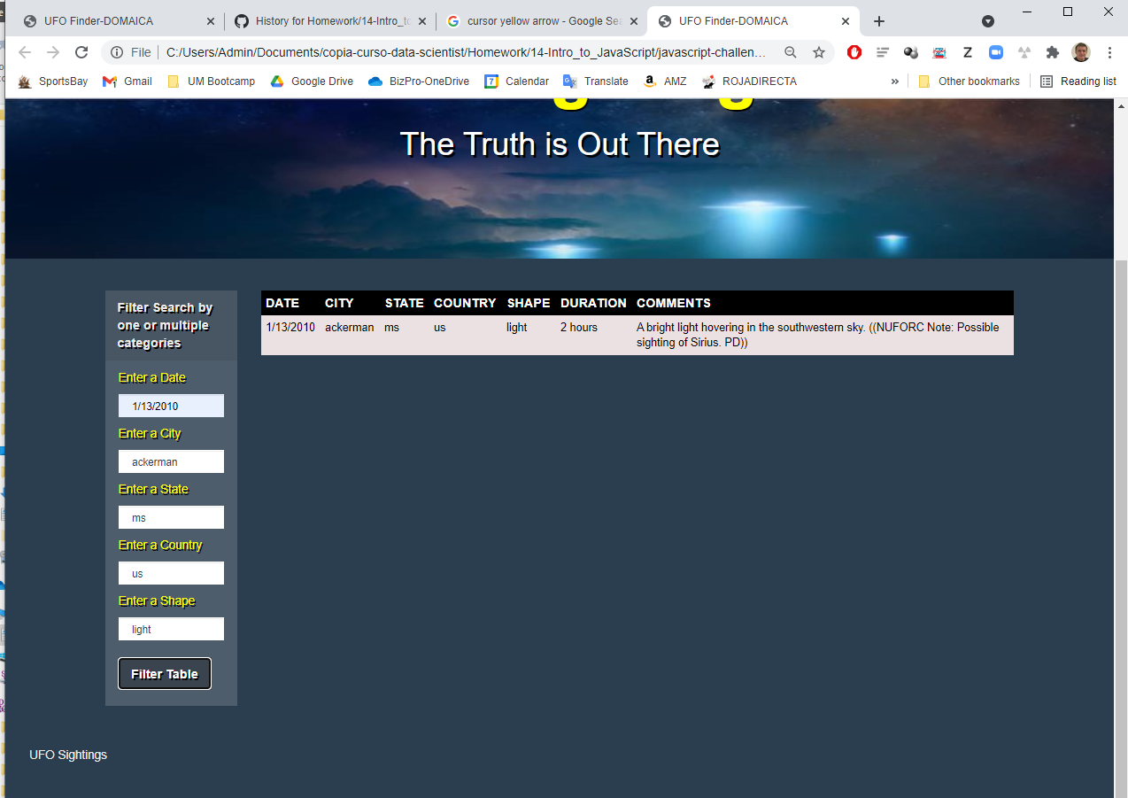
UFO-LEVEL-2. Results filtering on multiple categories:
Date: 1/13/2010
City: ackerman
State: ms
Country: US
Shape: light

Slide 13
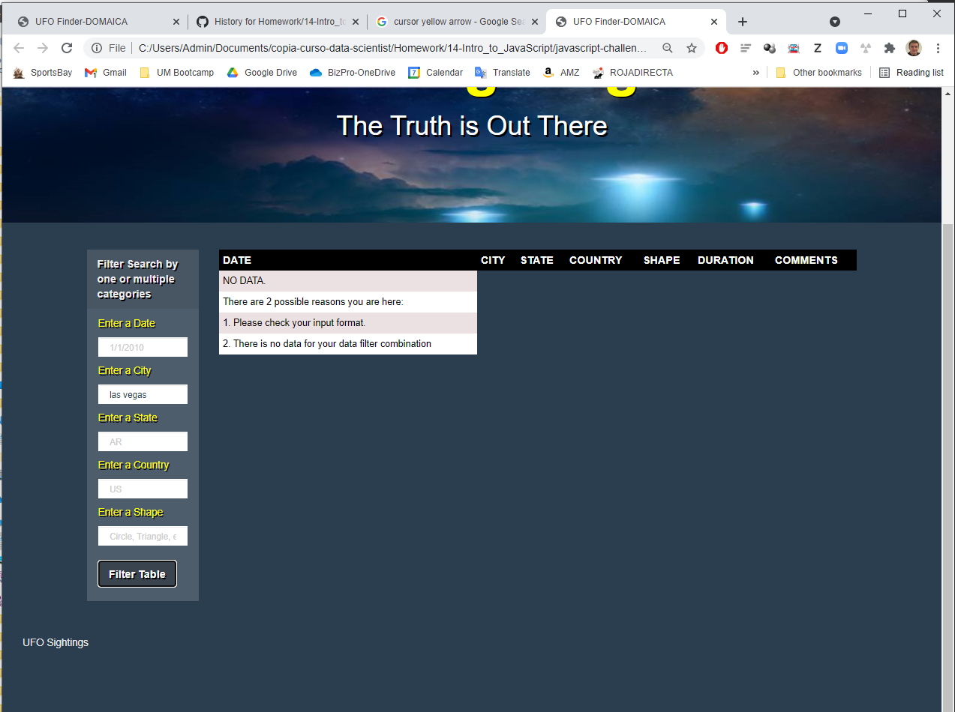
UFO-LEVEL-2. ERROR. No data for city ‘Las Vegas’

Slide 14
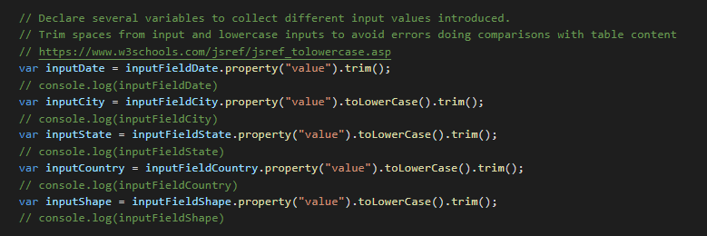
UFO-LEVEL-2. Correction of input data
If input has spaces before of after introduced date, it works by trimming spaces
If characters are written in capital letters, system lowercase it

Slide 15
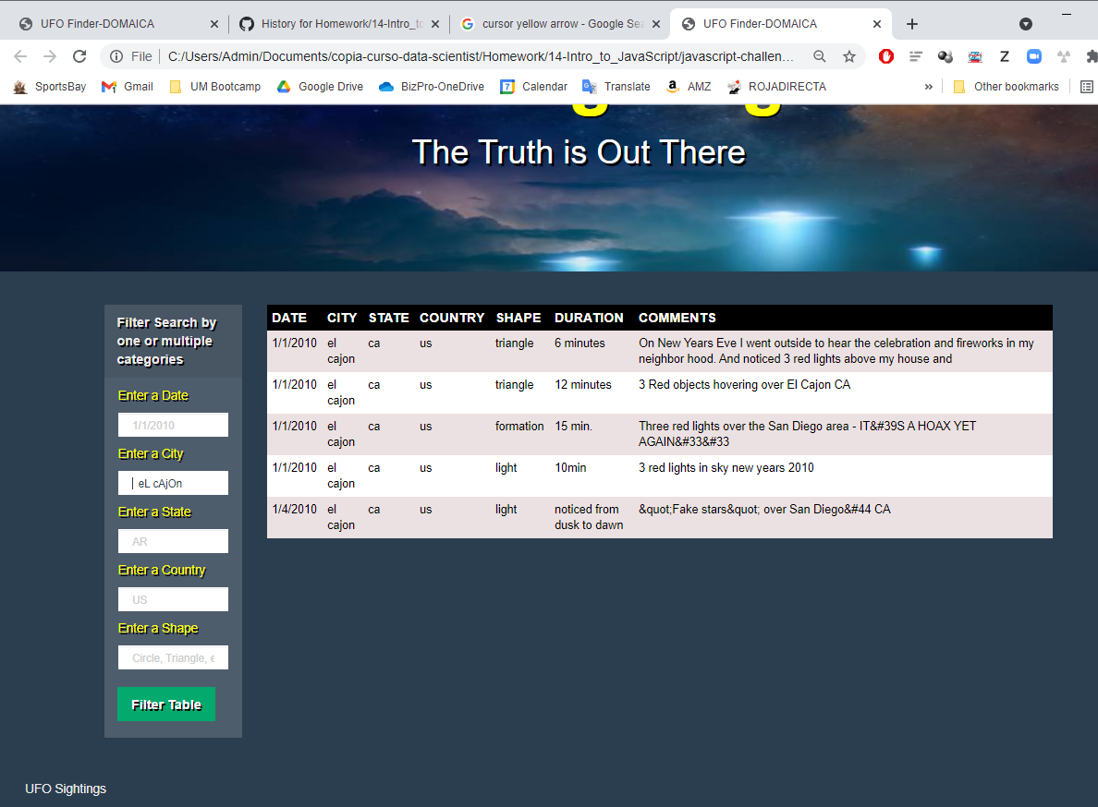
UFO-LEVEL-1. Trimming and lowercase example.
Space added before city name and toggle capital letters
& still filtering proper results

